Slide 1
Physical Electronics lecture-5
X-Ray Diffraction(Bragg's Law)
Dr. Suha I. Al- Nassar

Slide 2
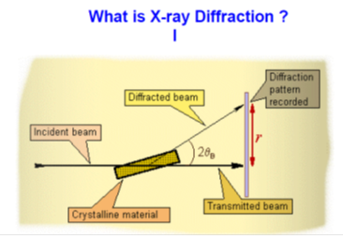
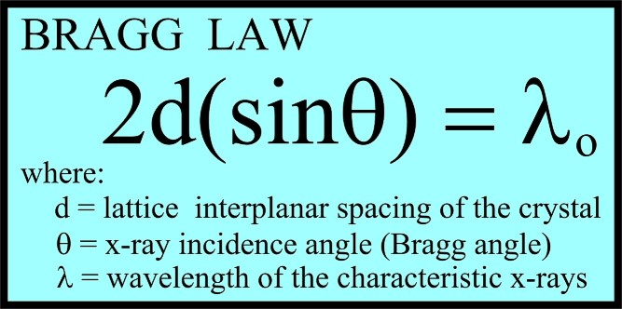
X-Ray Diffraction(Bragg's Law
X-rays are electromagnetic radiation of wavelength about 1 Å (10⁻¹⁰ m), which is about the same size as an atom.
The discovery of X-rays in 1895 enabled scientists to probe crystalline structure at the atomic level. X-ray diffraction has been in use in two main areas, for the fingerprint characterization of crystalline materials and the determination of their structure. We can determine the size and the shape of the unit cell for any compound most easily using X-ray diffraction. X-ray Diffraction Structural Analysis
X-ray diffraction provides most definitive structural information
.Interatomic distances and bond angles X - rays
To provide information about structures we need to probe atomic distances this requires a probe wavelength of 1 x 10⁻¹⁰ m ~Angstroms

Slide 3
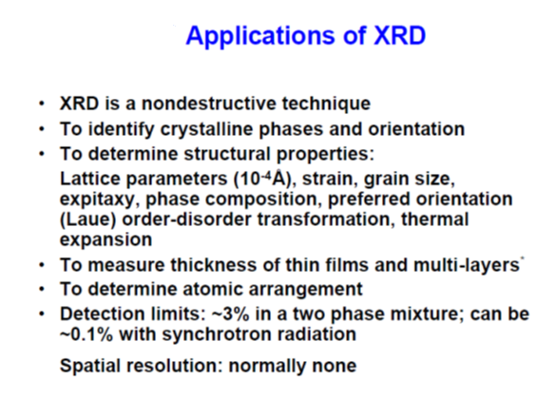

Slide 4


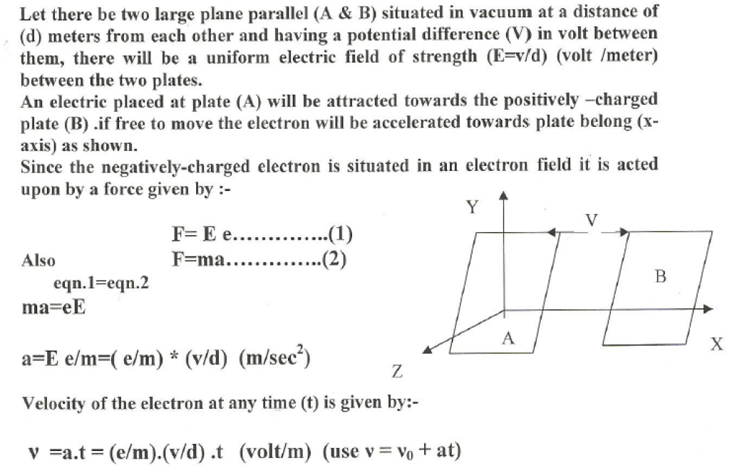

Slide 5

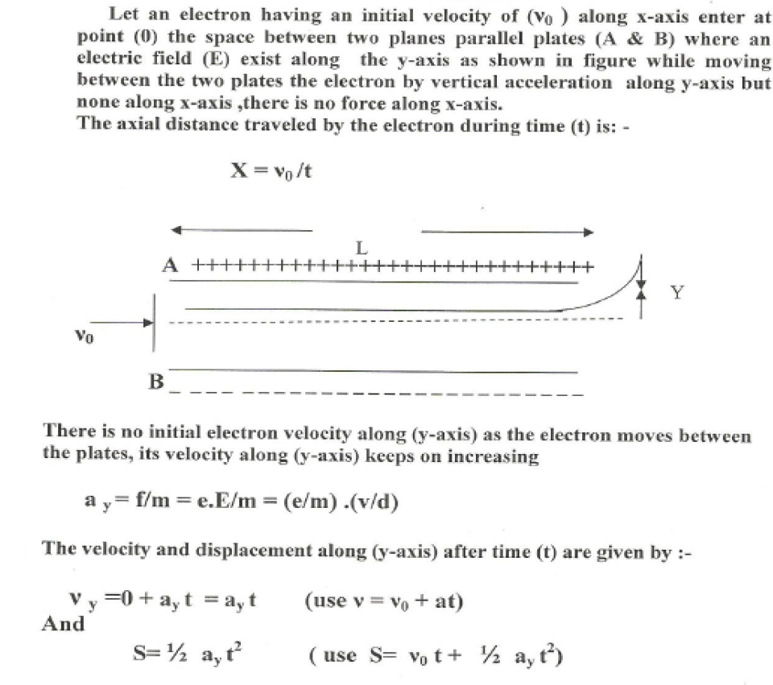

Slide 6
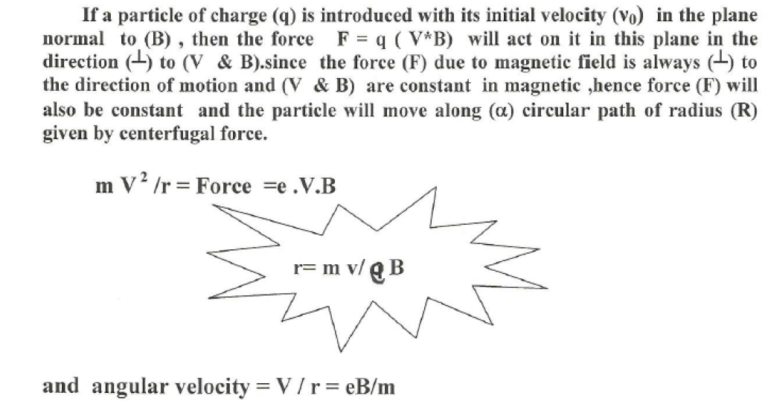

Slide 7
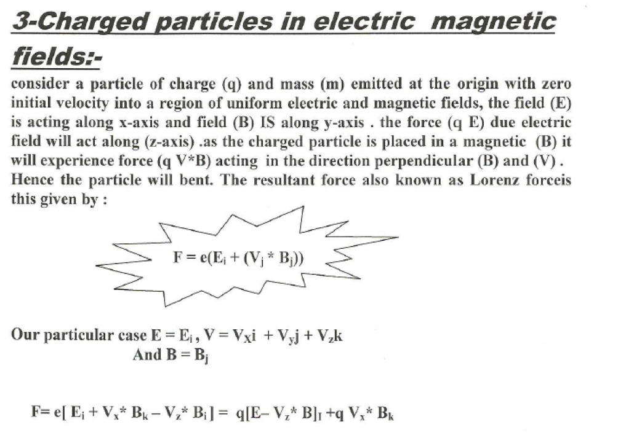

Slide 8

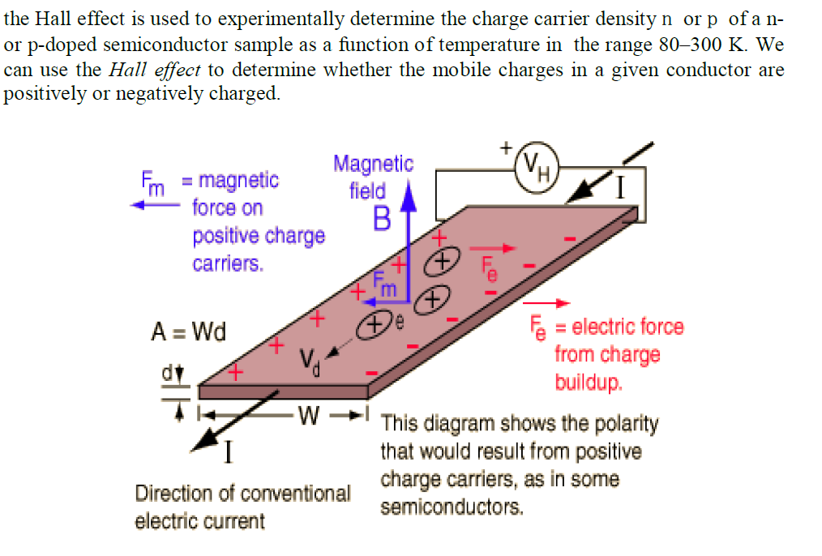

Slide 9
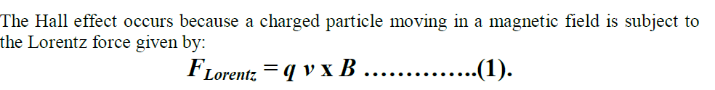
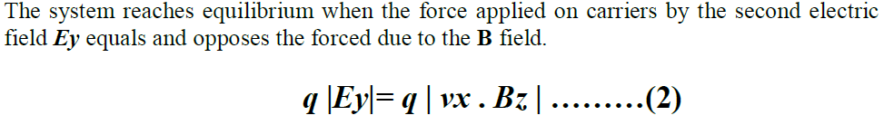
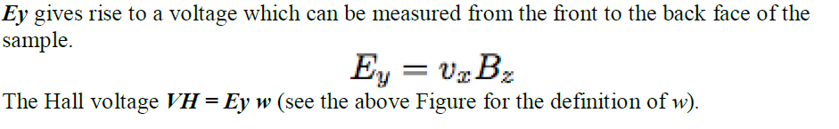
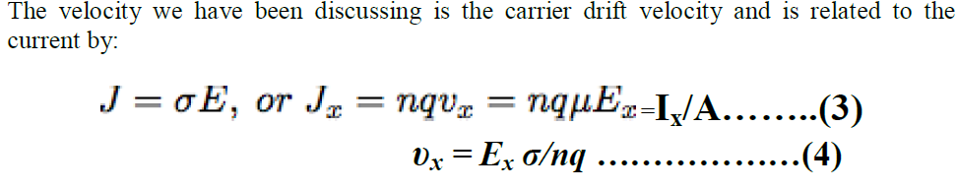

Slide 10
